Slide 1



Pro Kabaddi League Sports Analysis
Anjali Prajapati

Slide 2


Introduction:
Establishment: Pro Kabaddi League (PKL) is a professional kabaddi league in India.
Inception: It was founded in 2014.
Managed By: PKL is managed by Mashal Sports in partnership with the Amateur Kabaddi Federation of India (AKFI).
Growth of Kabaddi: It has played a crucial role in revitalizing and popularizing the traditional Indian sport of kabaddi.
2

Slide 3


Objective:
To determine whether venue affects the match results of the Jaipur team in pro kabaddi league 9.
To assess whether the proportion of successful raids is significantly different from the proportion of successful tackles.
3

Slide 4


Methodology:
Data Collection
Secondary data sets are taken related to pro kabaddi league.
Software Used
Statistical Methods
- Chi-Square Test
- Proportion Test

Slide 5
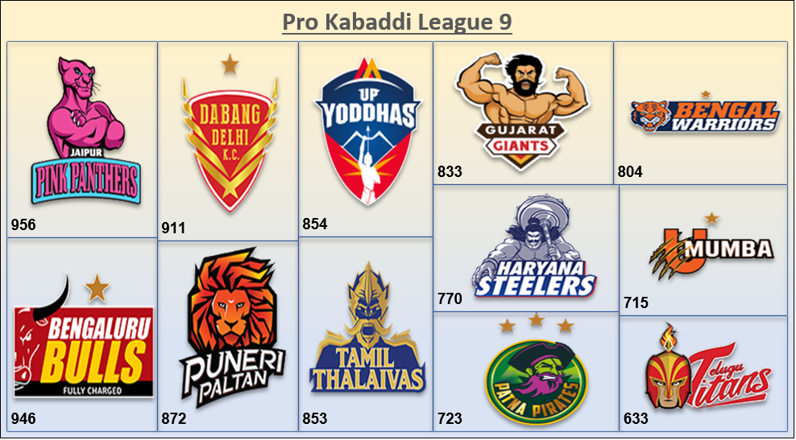
Data Analysis Using Graphs:

Slide 6
Data Analysis Using Graphs:

Slide 7
Data Analysis Using Graph:

Slide 8
Objective-1:
To determine whether venue affects the match results of the Jaipur team in pro kabaddi league.
Assumptions for Chi-Square test:
Two categories for each variable.
There is no relationship between the variables.
Categorical variables are not paired in any way.
Hypothesis:
H₀: There is no association between the match result and the venue.
H₁: There is an association between the match result and the venue.

Slide 9
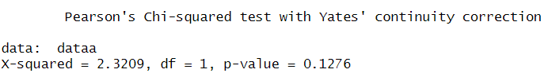
Result:
The calculated p-value is 0.1276.
It is greater than the standard value.
i.e. p-values>0.05
Therefore, we do not reject null hypothesis H₀.

Slide 10

Objective-2:
To assess whether the proportion of successful raids is significantly different from the proportion of successful tackles.
Assumptions for Proportion test:
Individual observations should be independent of each other.
The variable being analyzed must be categorical with two possible outcomes.
Hypothesis:
H₀: P₁=P₂
The proportion of successes in raids is equal to the proportion of successes in tackles.
H₁: P₁$≠$P₂
The proportion of successes in raids is not equal to the proportion of successes in tackles.

Slide 11
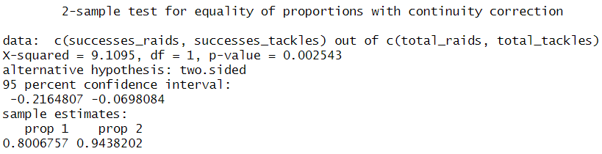
Result:
The p-value of 0.002543 is less than a typical significance level of 0.05, indicating to reject the null hypothesis.
The confidence interval also supports this conclusion, as it does not include zero, further indicating a significant difference.
The hypothesis for this test is that, There is a significant difference in the proportions of successes between raids and tackles in Kabaddi.

Slide 12
Thank You☺

